Slide 1






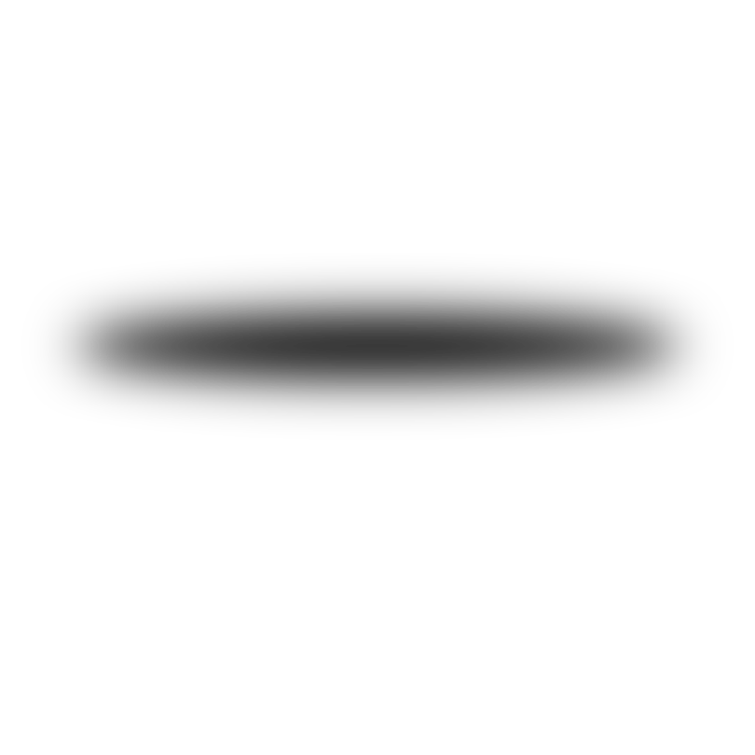
Microsoft 2019 - 2024
Stock Price Prediction
Amr Amer ,Mohamed Fouad , Mohamed Eissa , Mohamed Ashour, Karim Shahine

Slide 2

Introduction
Problem Statement:
The complexity and volatility of stock prices make accurate prediction challenging.
Objective: To predict Microsoft stock prices using various time series and machine learning models.

Slide 3
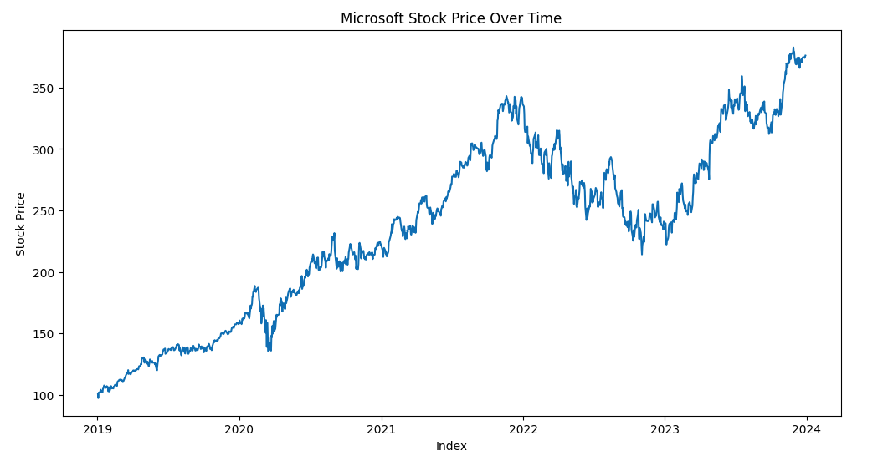
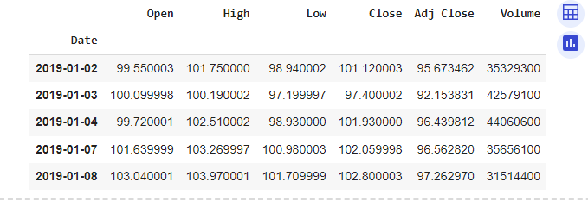
Dataset
Historical Microsoft stock prices from January 2019 to January 2024.
Attributes: Open, High, Low, Close, Adjusted Close, Volume.
Data Source: Obtained using yahoo finance library.

Slide 4
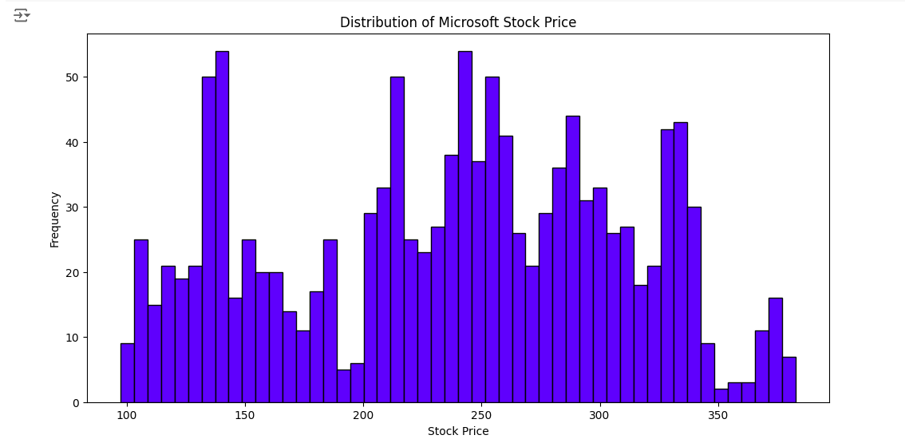
Exploratory Data Analysis
Graph 1: Distribution of Microsoft Stock Prices
Histogram showing the distribution of the closing prices.
Insights: The stock prices are mostly concentrated between certain price ranges with some outliers.

Slide 5
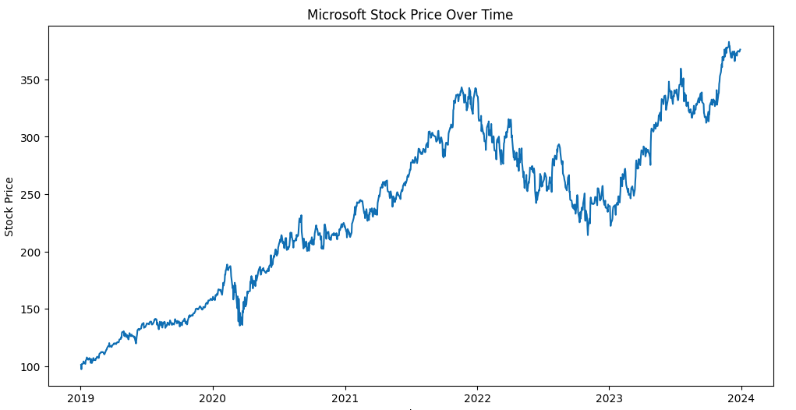
Exploratory Data Analysis
Graph 2: Microsoft Stock Price Over Time
Line chart showing the closing prices over the entire dataset period.
Insights: There are noticeable trends and fluctuations, indicating periods of growth and decline.

Slide 6
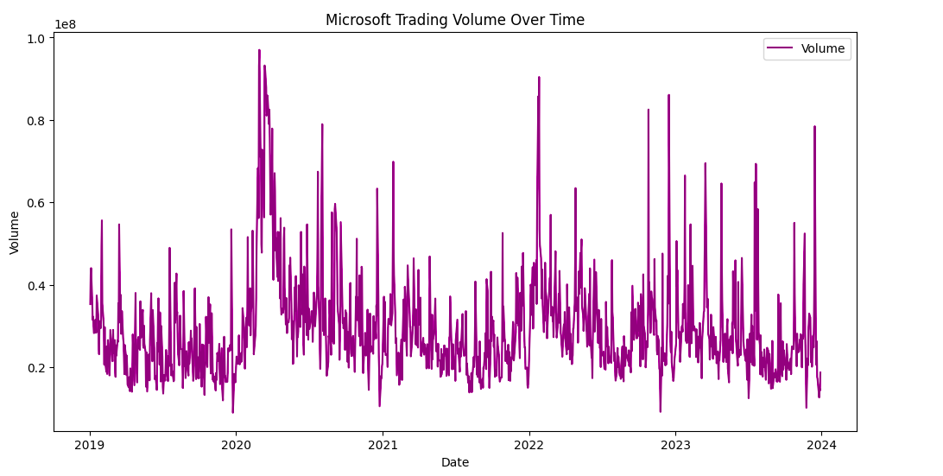
Exploratory Data Analysis
Graph 3: Trading Volume Over Time
Line chart showing the volume of stocks traded over time.
Insights: Volume spikes correspond with significant price changes, indicating market activity.

Slide 7
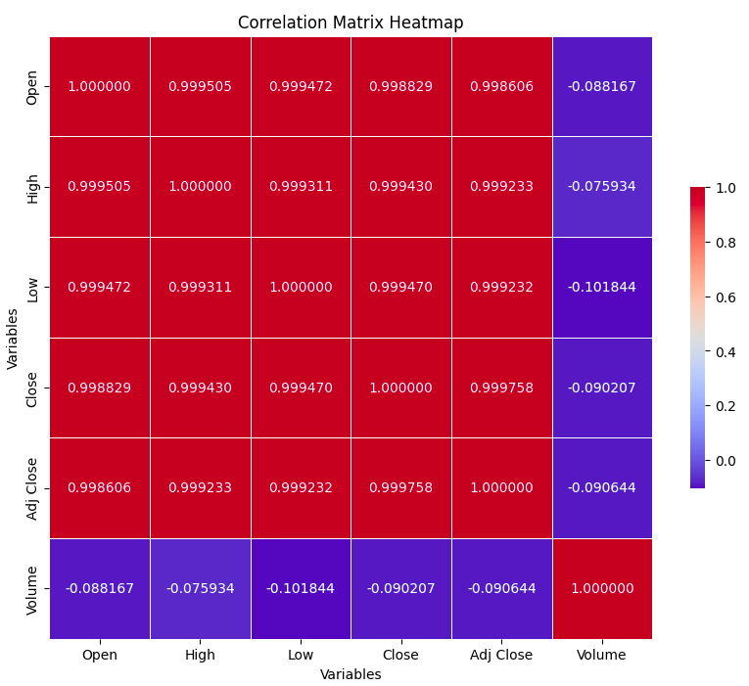
Exploratory Data Analysis
Correlation Matrix Heatmap
Very High Correlation Among Price Variables: Open, High, Low, Close, and Adjusted Close prices.
The strong correlations among price variables suggest that models using one price variable could potentially predict others.

Slide 8
Methodology
Model Implementation:
ARIMA and SARIMA Models:
ARIMA: Captures linear dependencies.
ARIMAX: Incorporates external variables.
SARIMA: Accounts for seasonality.
SARIMAX: Seasonal model with exogenous variables.
VAR and VARMAX Models:
VAR: Multivariate time series.
VARMAX: Includes moving average components and external variables.
Deep Learning Models:
LSTM: Long Short-Term Memory model.
GRU: Gated Recurrent Unit model.
CNN: Convolutional Neural Network adapted for time series.

Slide 9
Model Training and Evaluation
Training: 80% of data used for training, 20% for testing.
Evaluation Metric: Root Mean Squared Error (RMSE).
For stock price prediction, the primary metric of interest is usually the RMSE (Root Mean Squared Error). RMSE measures the average magnitude of the errors between predicted and actual values and is particularly useful in regression problems where we are concerned with how close our predictions are to the actual stock prices.

Slide 10
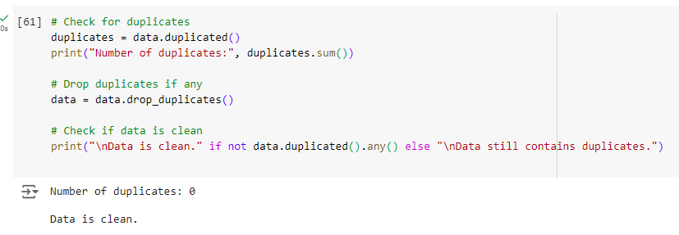
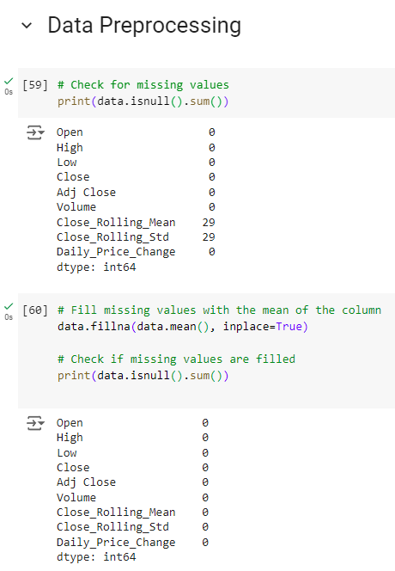
Data Preprocessing
Steps:
Handling missing values by filling with mean.
Removing duplicates.
Normalization using MinMaxScaler.
Feature Engineering:
30-day moving average and standard deviation.
Lagged values for 1-day and 7-day periods.
Daily price change calculation.

Slide 11
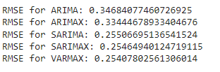
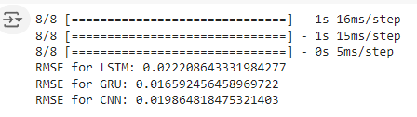
Performance Comparison
Steps:
Select The best Performing Models: LSTM, GRU, CNN
Make a Predicted vs Actual Prices Line chart comparing the predicted prices from each model with the actual closing prices.
Insights: Visual representation of each model's accuracy in predicting stock prices.

Slide 12
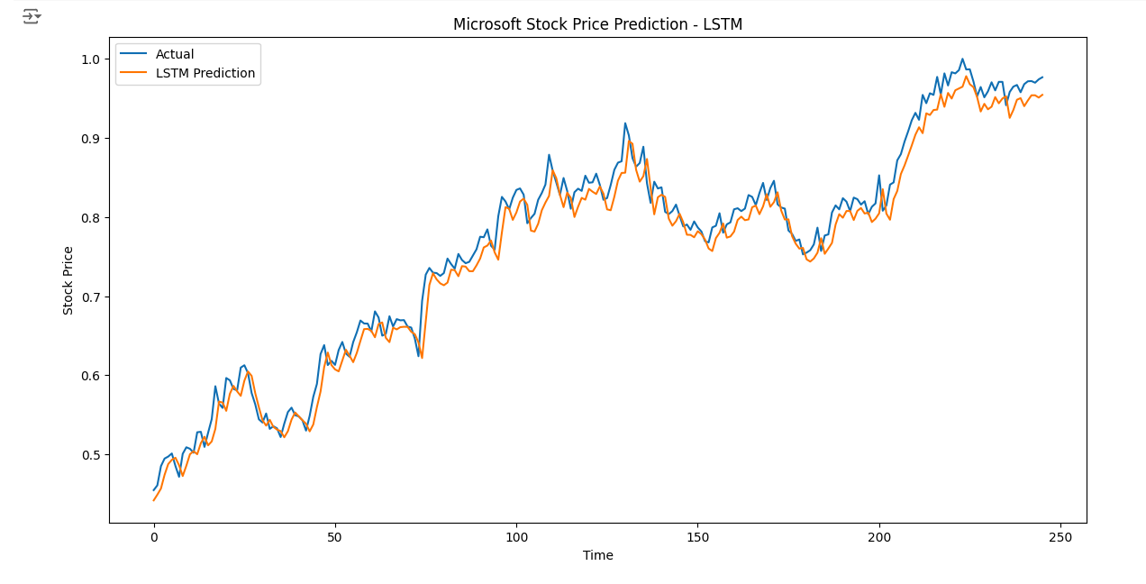
Performance Comparison
LSTM

Slide 13
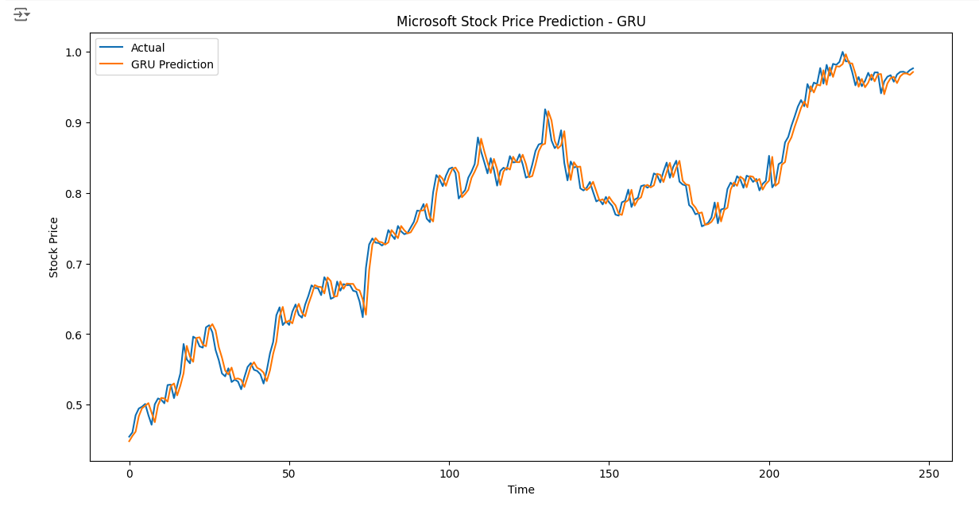
Performance Comparison
GRU

Slide 14
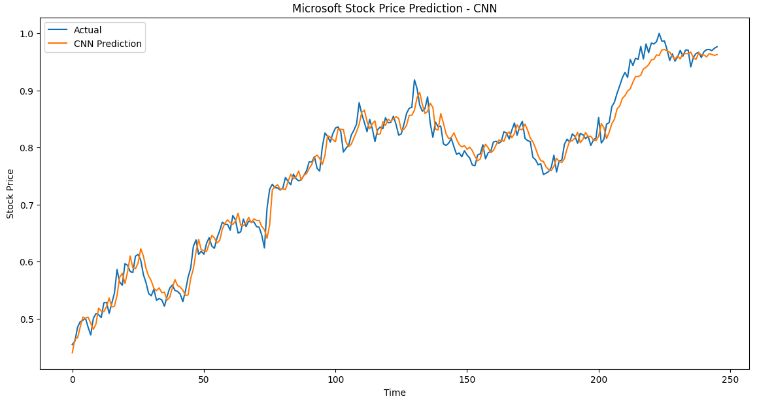
Performance Comparison
CNN

Slide 15
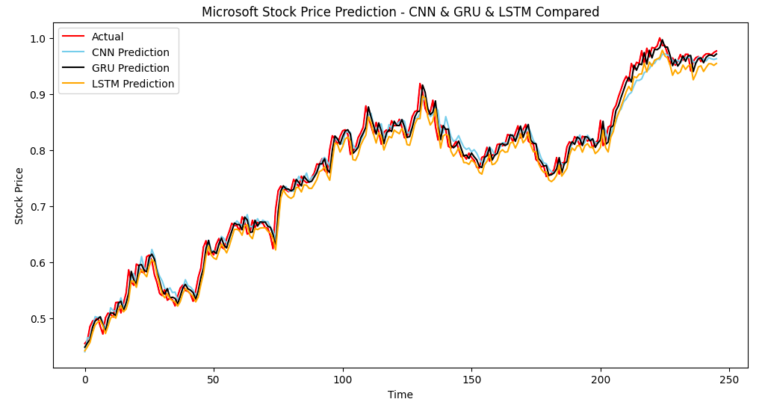
Performance Comparison
GRU WINS

Slide 16
Key Observations and Insights
GRU Model Performance:
Best Performer: The GRU (Gated Recurrent Unit) model demonstrated the best performance among all the models, with an RMSE of 0.2519.
Efficiency and Accuracy: GRU outperformed LSTM and other models, possibly due to its simpler architecture which makes it computationally efficient while still effectively capturing temporal dependencies in the stock price data.
Significance: The GRU model's ability to manage long-term dependencies and avoid the vanishing gradient problem common in traditional RNNs contributed to its superior performance.

Slide 17

Thank You
for Listening!

